Slide 1
Introduction to Dev Sec ops The Era has changed
Vikas

Slide 2
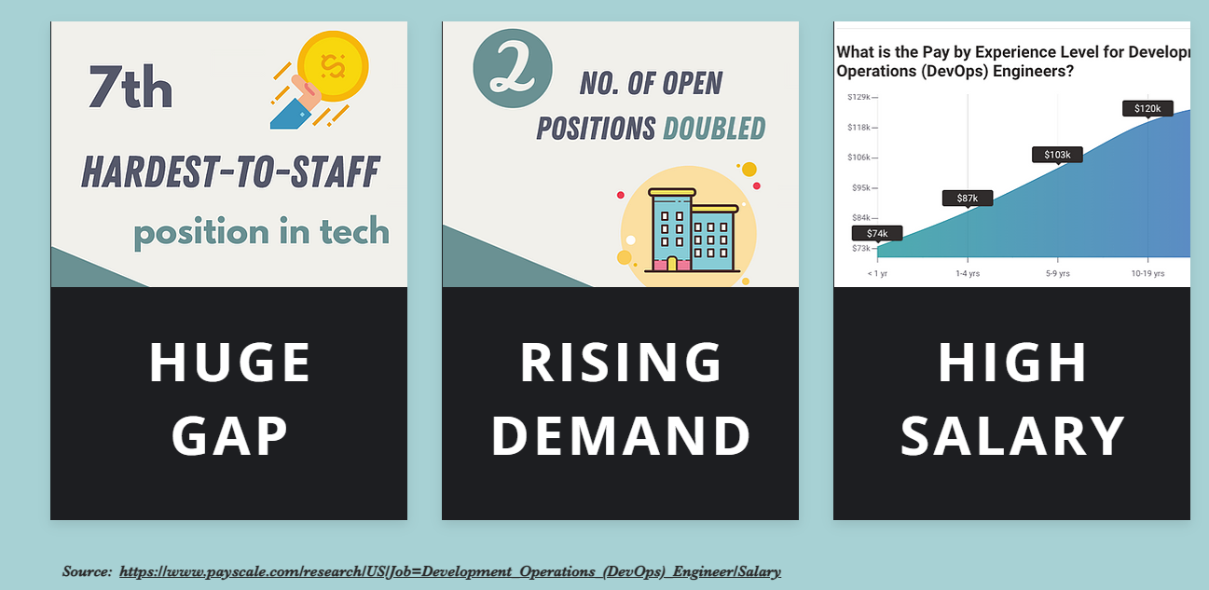
Notes:
. My name is vikas . I am working for a MNC in Bangalore
. I am a consultant and trainer on DEV-SEC-OPS techniques.
. I have a background of cloud security and networking with LINUX and UNIX.
. Now a days I have working directly indirectly across almost all the thing that is related to cloud and dev-sec-ops .
. I have a vast training experience and have virtual presence on multiple online portals .

Slide 3
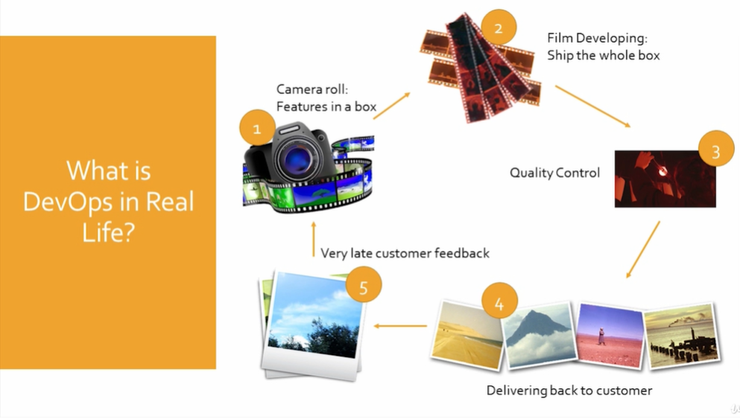
Notes:
Time
Automation
Quality
https://aws.amazon.com/devops/what-is-devops/

Slide 4
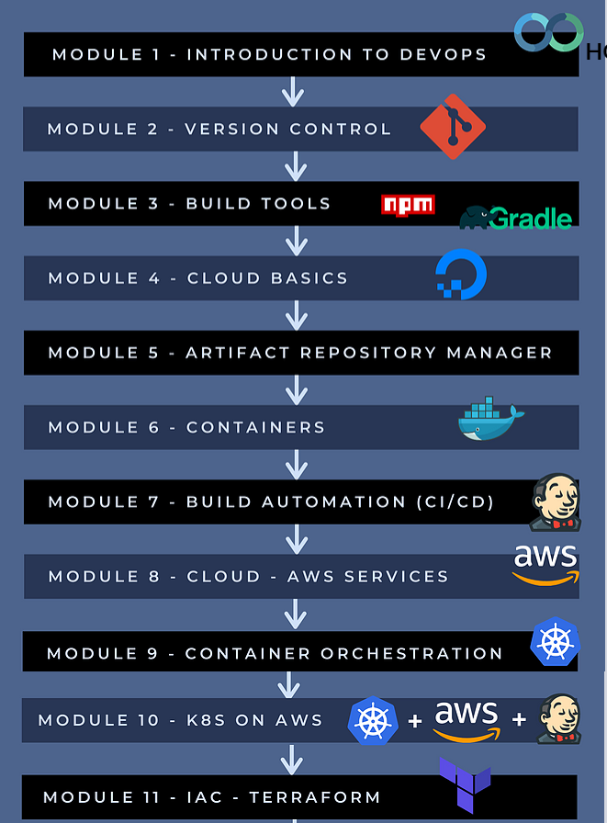


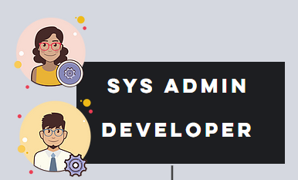
Notes:
learnt many technologies, but don’t know how to use them together
don’t know how real-life examples look like, so don’t feel confident you can really use these tools in practice
We train you as a devops engineer where the knowledge and confidence that you gain will help you to handle the DevOps tasks at your job

Slide 5
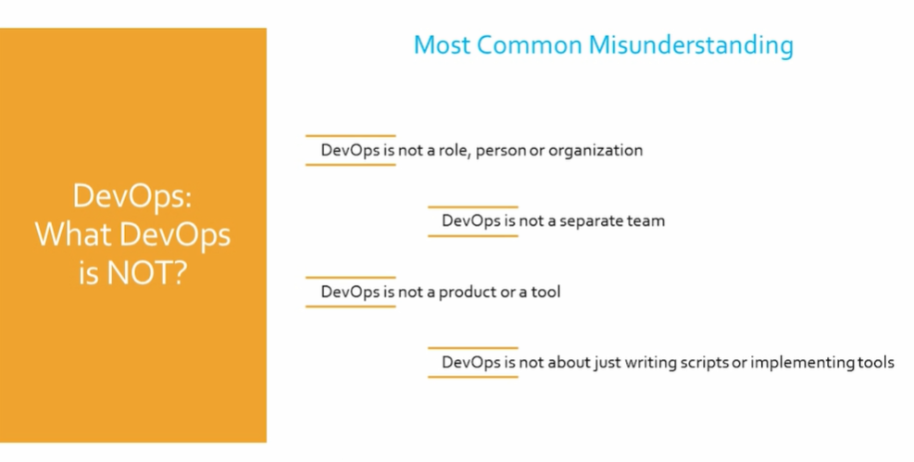

Slide 6
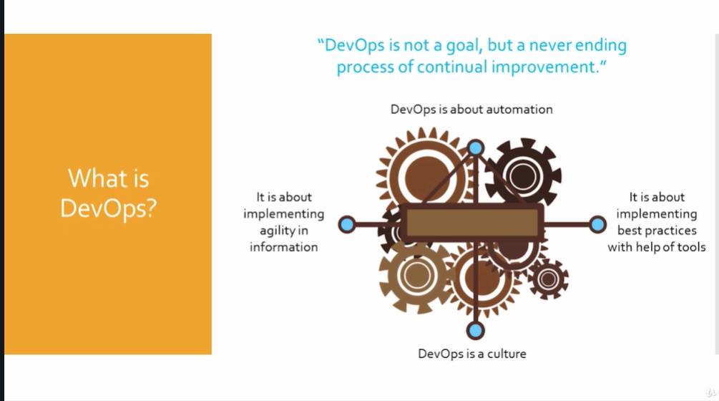
Notes:
Customer happiness :
Fast and quality delivery
No down time
Less spend on capex and opex

Slide 7
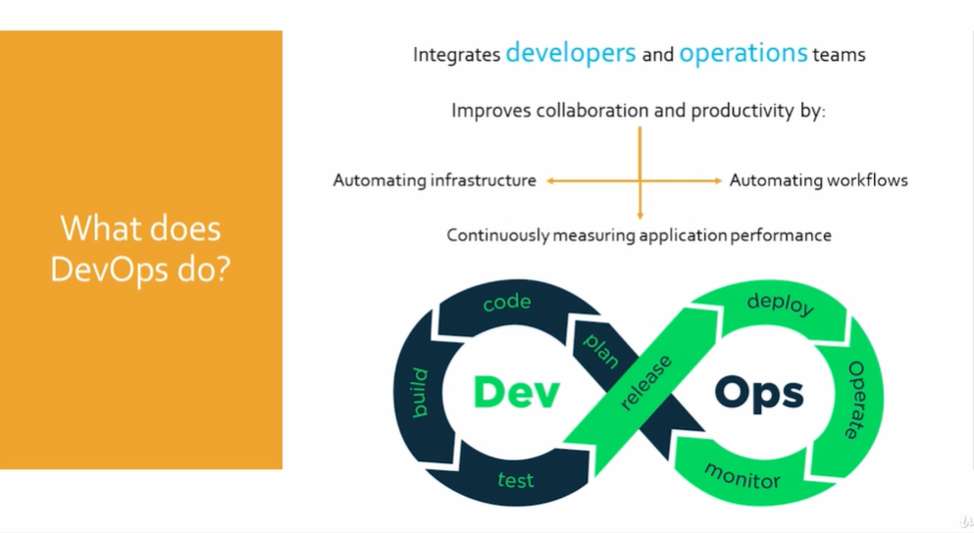

Slide 8
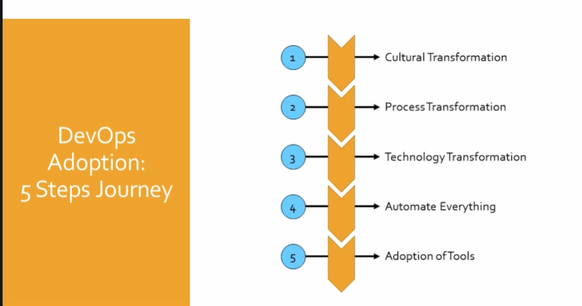

Slide 9
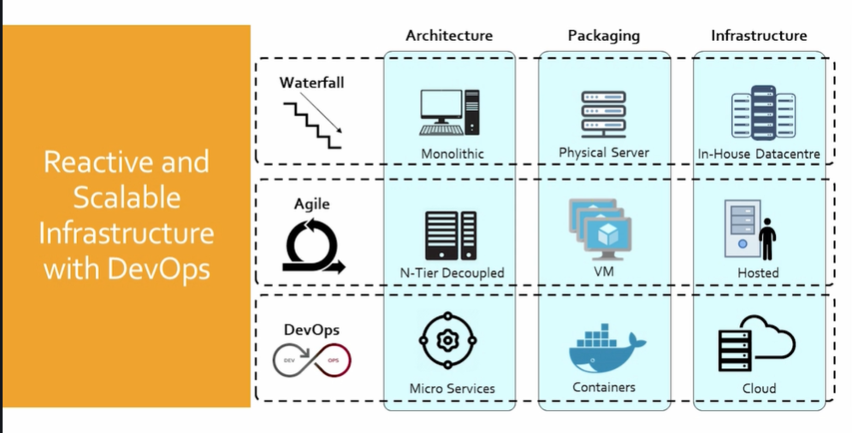

Slide 10
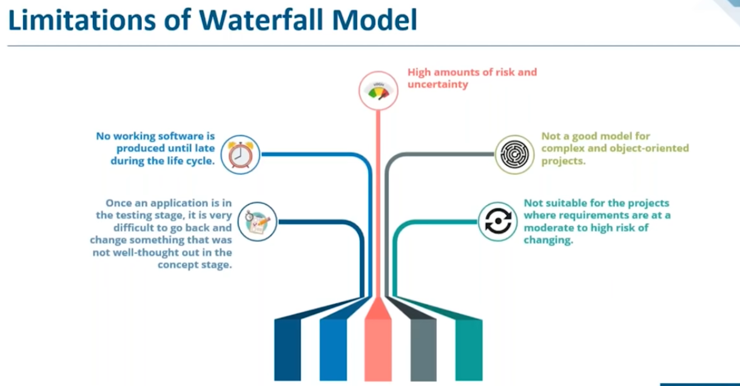
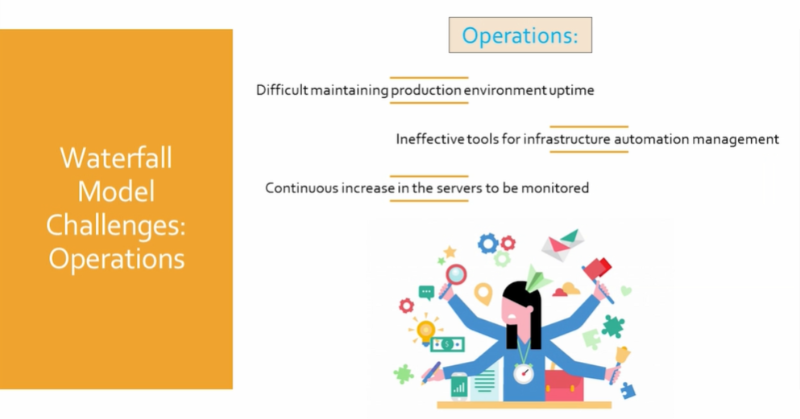
Notes:
Traditional Waterfall Model Stages:
Requirement Gathering and analysis
Design and Coding
Unit Testing and system Testing
Implementation to UAT
Deployment to production
Monitoring and maintenance
Limitation of the waterfall Model :
High amount of risk and uncertainty .
Not good for complex and projects where requirement changes frequently .
No working software is produced until later stages .
Team working on silos

Slide 11
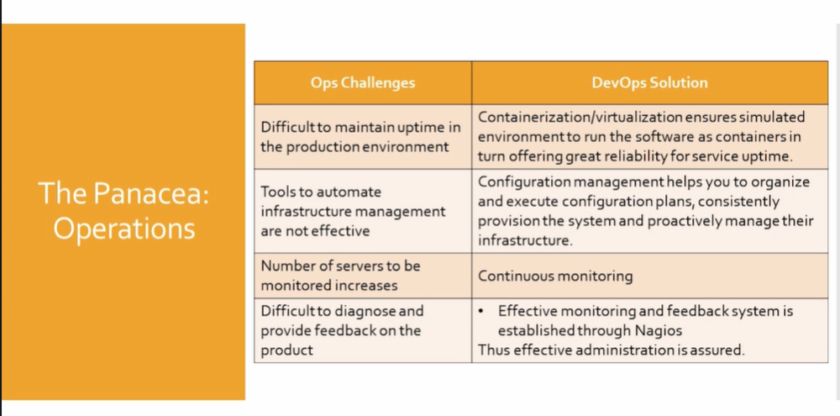

Slide 12
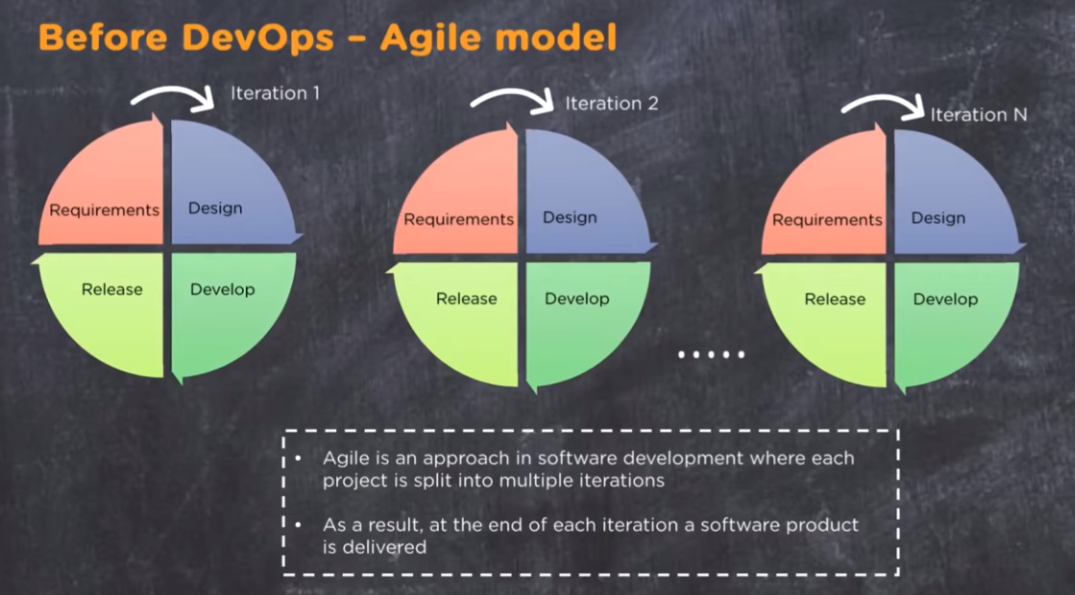
Notes:
Project broken into several iterations of 2 to 8 weeks and delivered as per the schedule .

Slide 13
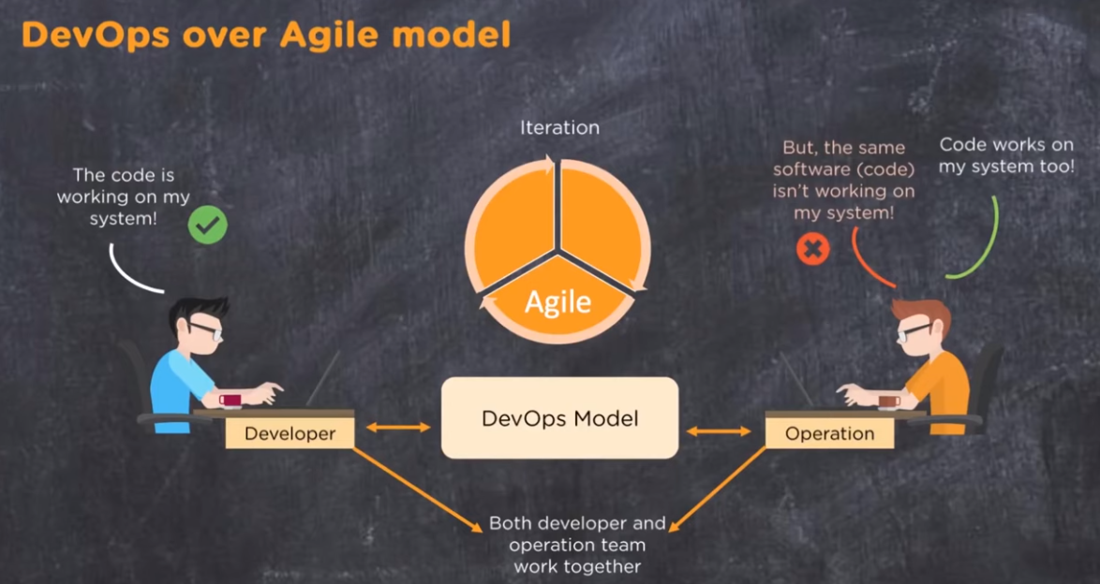

Slide 14
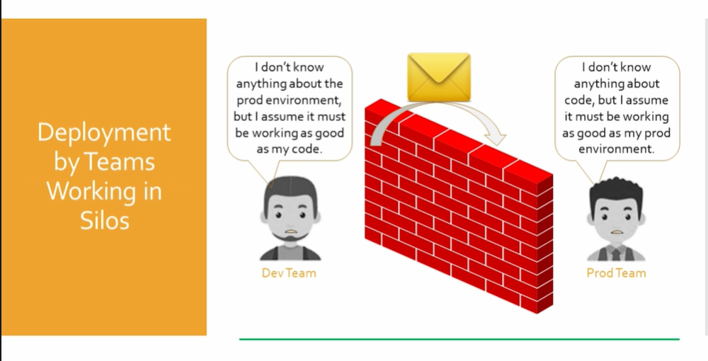

Slide 15
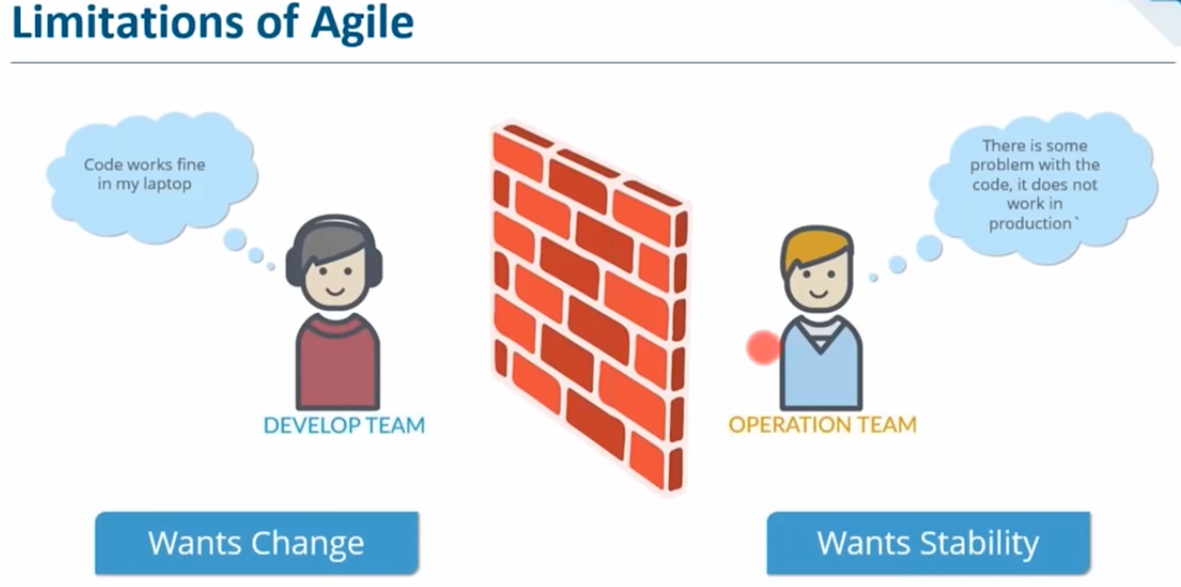
Notes:
Development : coding + design + testing :: Developer + QA Engineer + Release Managers + Build & support Engineers + Program Managers
Operations : Admin + network + DBA + Infra :: System admin + network admin + middleware admin + storage admin+ deployment Engineer [Infra Management ]
To automate the entire process so that the delivery is fast and effective ,which is not one phase alone .

Slide 16
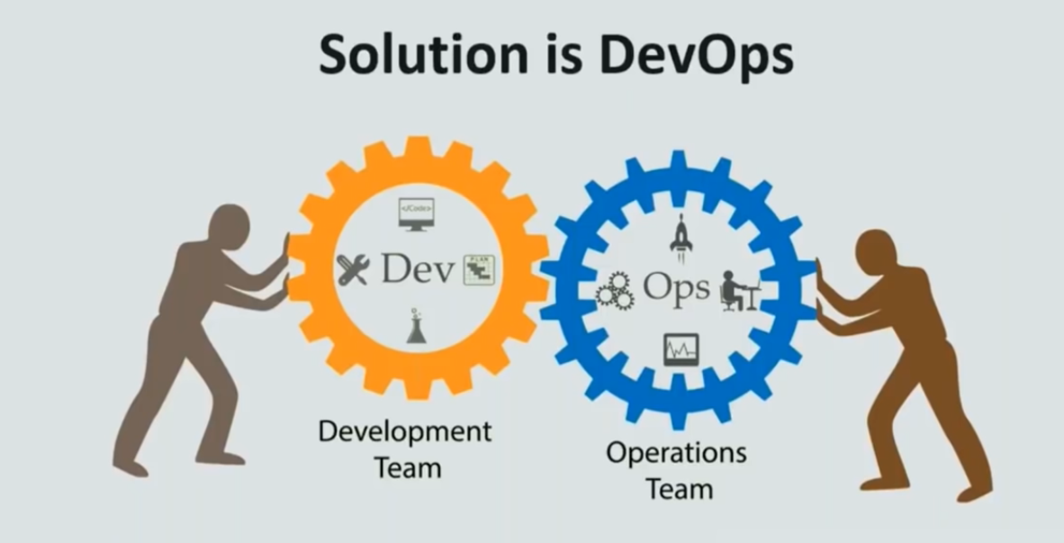
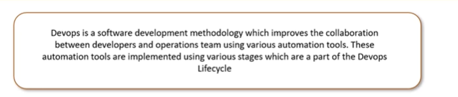
Notes:
Dev ops is a culture , a philosophy where Developer and Operation team can collaborate and participate together in agile practice through entire software lifecycle ,from development to production support .
Devops is not learning fancy tools .It’s about people solving problems together .

Slide 17
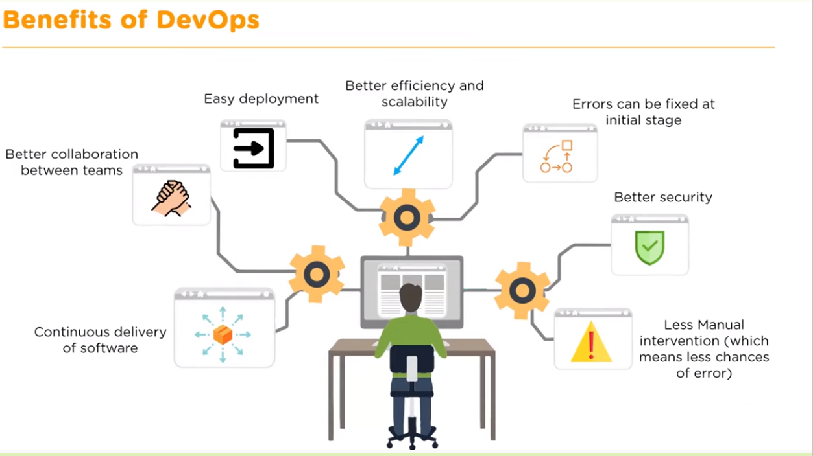

Slide 18
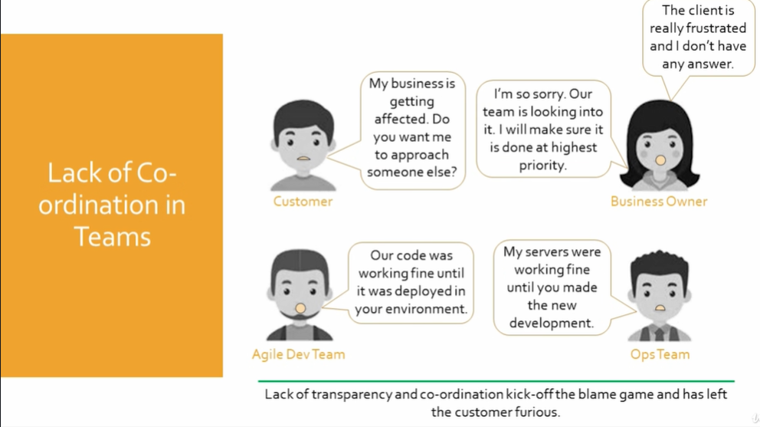

Slide 19
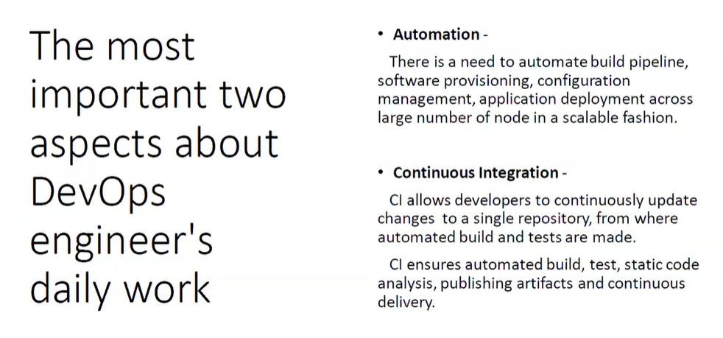

Slide 20
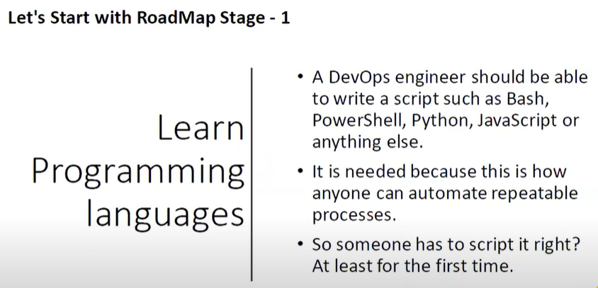
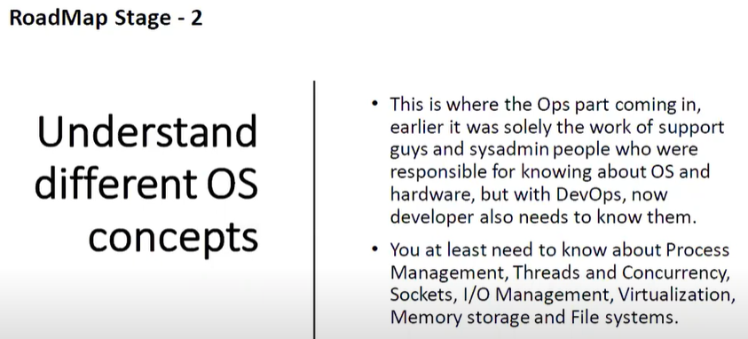
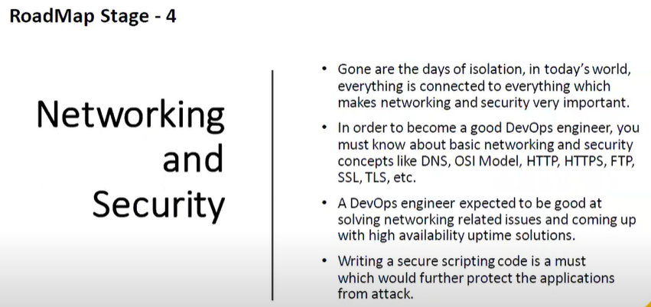
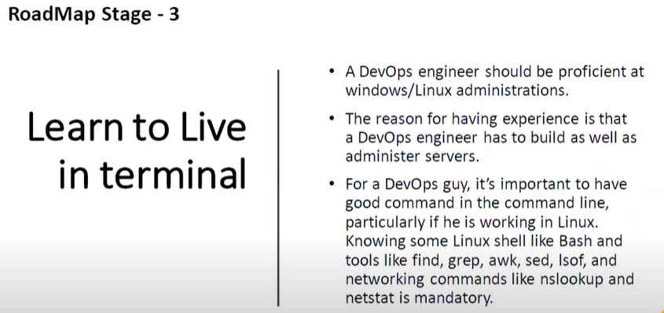

Slide 21
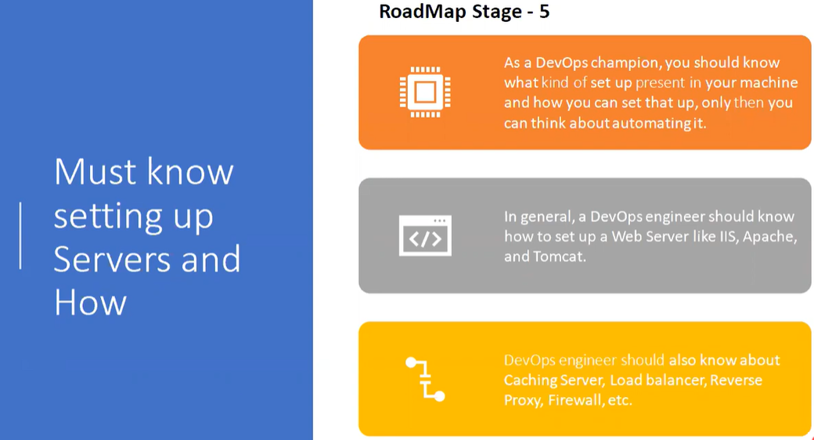
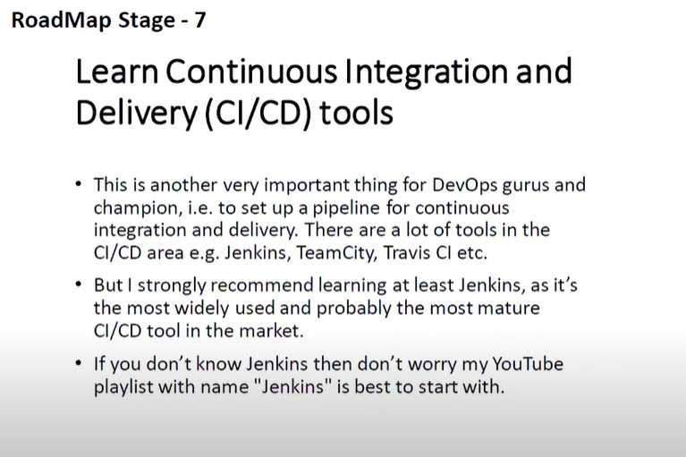
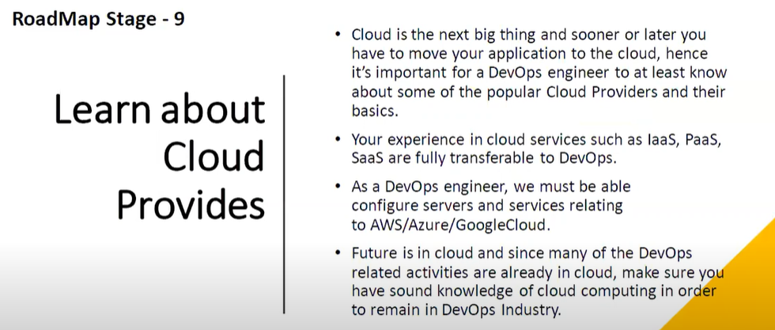
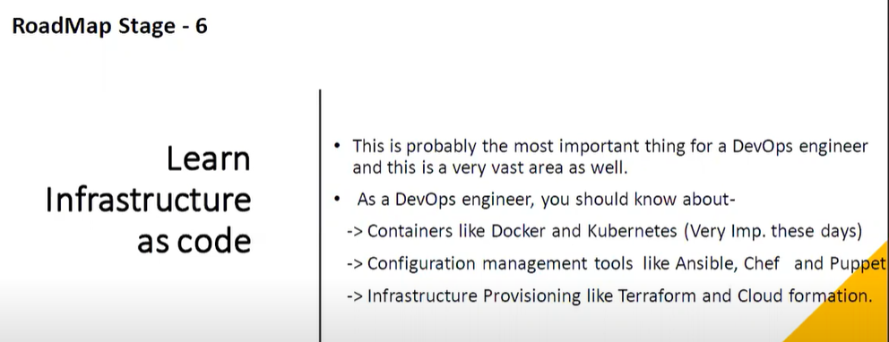
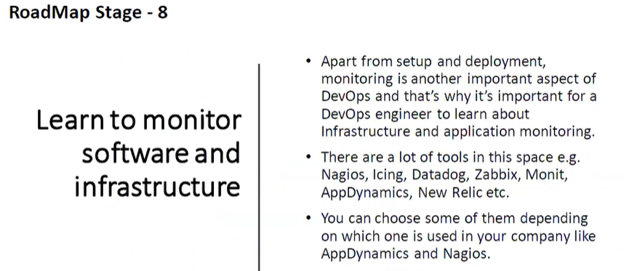

Slide 22
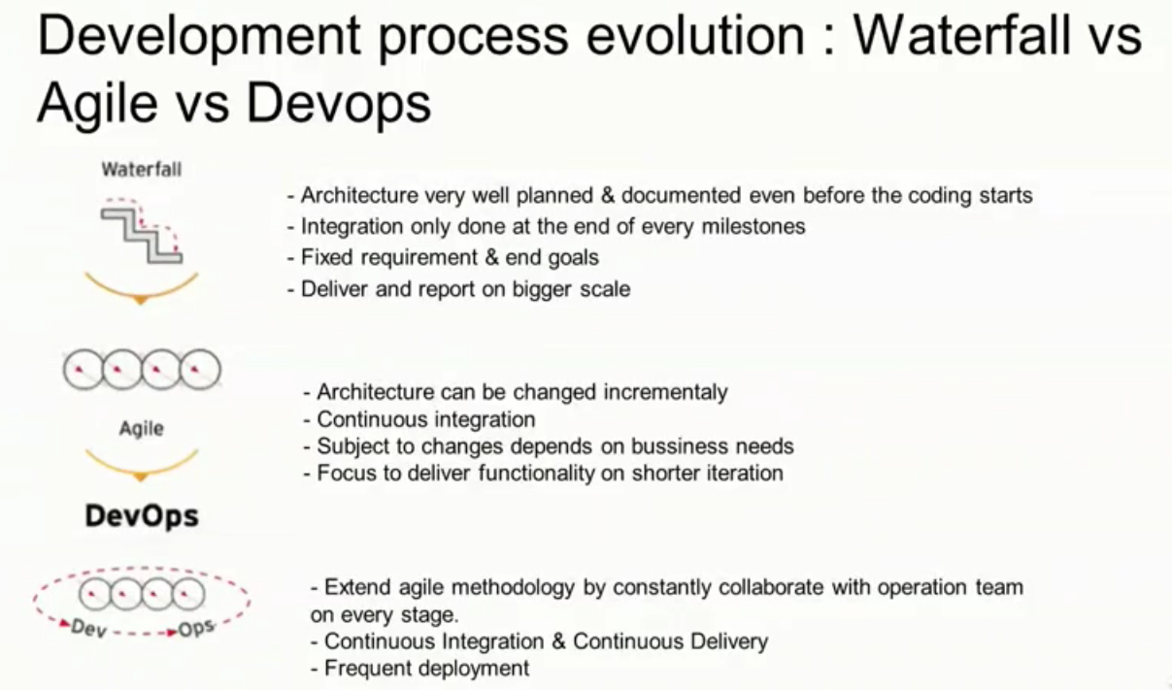
Notes:
https://www.forbes.com/sites/mikekavis/2017/11/17/the-four-stages-of-devops-maturity/#7a2c31842f62
Things to know to become a Devops Engineer :
Linux Essentials
Version control system
Build management
Continuous Integration
Configuration Management
Virtualization
Cloud computing
Scripting

Slide 23
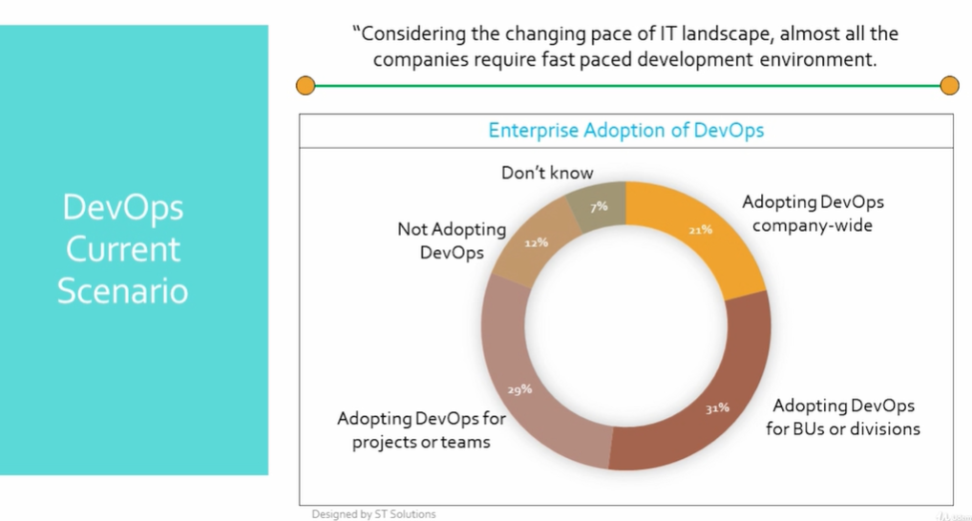

Slide 24
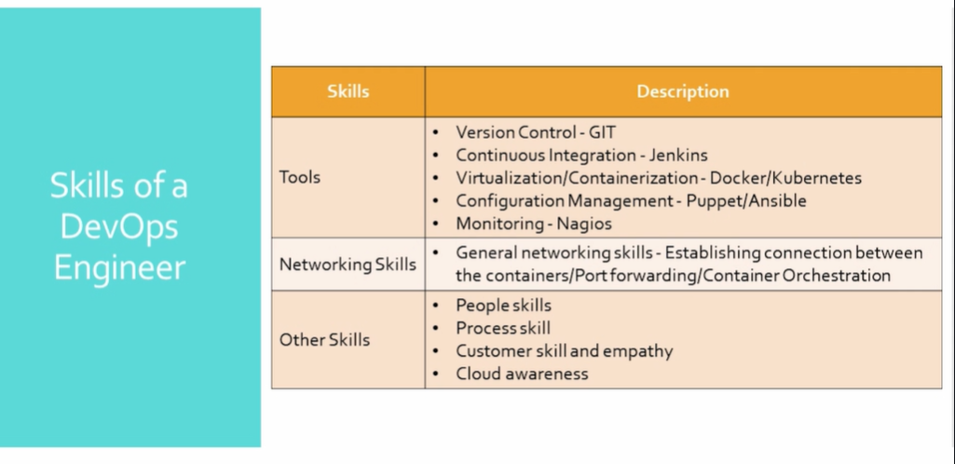

Slide 25
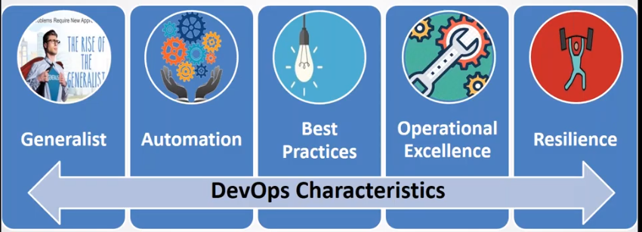
How to become a successful Devops Engineer :
Start cross-training now
Build the skill in the job you have for the job you want
Automate tasks
Community Involvement
Notes:
Generalist : can I put you somewhere else
Automation : Use tools to reduce effort and time
Best Practice : what can be automated and how can be done is most cost effective them
Operational Excellence : Maintenance should not be costly .
Resilience : Take responsibility
What are these best practice ?
Continuous Development + Continuous Testing + Continuous Integration + Continuous Delivery + Continuous Deployment + Iac + Configuration Management + Continuous Monitoring
Various Portfolio :
Cloud
Container
Core devops
Monitoring

Slide 26
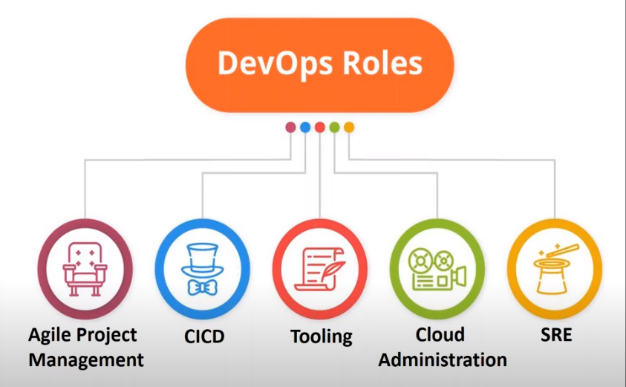
Notes:
Role of a DevOps Engineer :
CI/CD Activities : Work with Developer and operations to build a delivery pipeline for smooth and easy release of applications in every sprint or delivery cycle .
End to End Automation : To enhance smoother delivery of applications we use tools and custom scripts to automate manual work .
Infrastructure Automation : Smooth infrastructure implementation is a key to modern Dev ops culture .Use cloud environment to implement Iac .

Slide 27
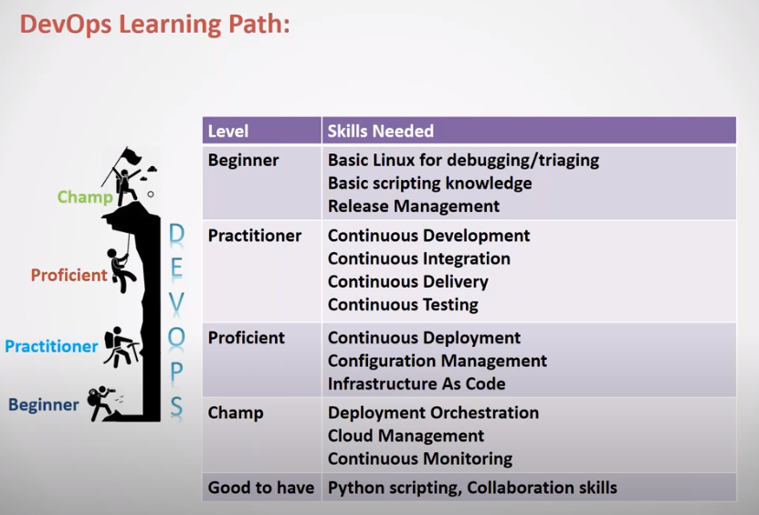

Slide 28
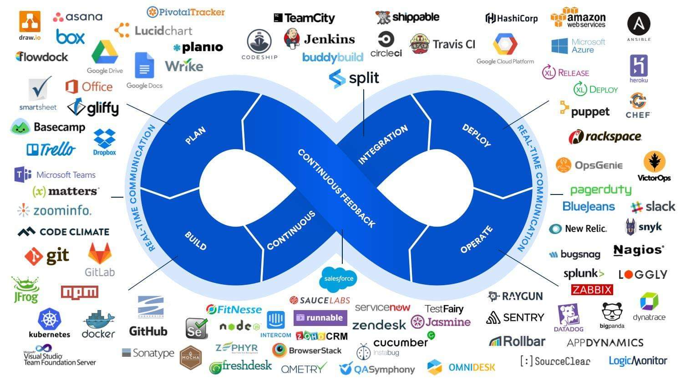
Notes:
Definition :
Similar Automation tools like Jenkins :
Bamboo
Solano CI
Circle CI
Teamcity
You can do any kind of automation
It’s written in JAVA
It’s a open source
Collection of plugins
http://pkg.jenkins.io/redhat-stable
sudo yum install java-1.8.0-openjdk-devel –y
java –version
Sudo chkconfig Jenkins on

Slide 29
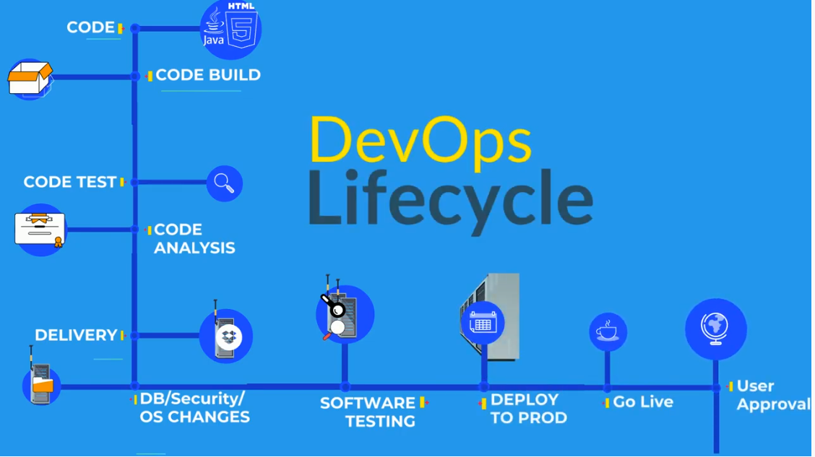

Slide 30
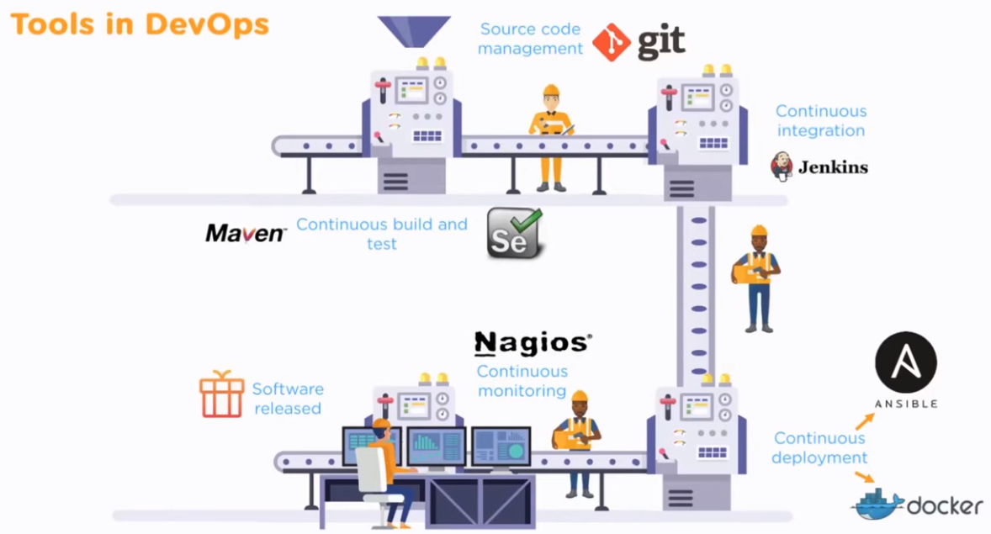
Notes:
Maven Stages :
1.Default/build
a . Validation
b. Compilation
c. Testing
d. Packaging
e. Install
f. Deploy
2. Clean – clear artifacts from previous builds
3. Site – used for reporting
POM – Project Object Model

Slide 31
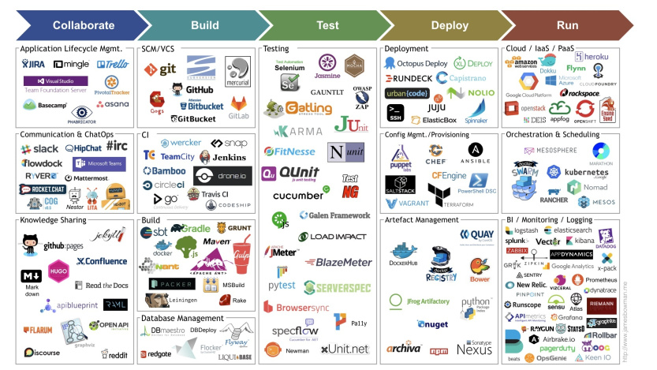

Slide 32
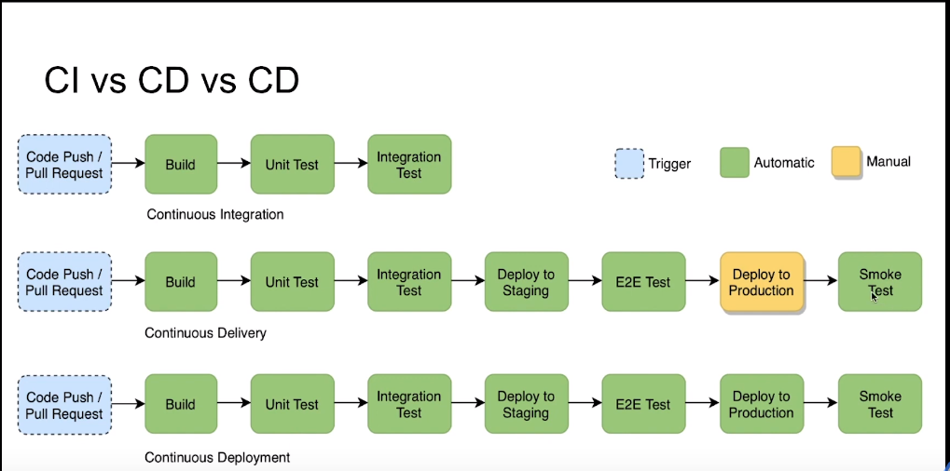

Slide 33
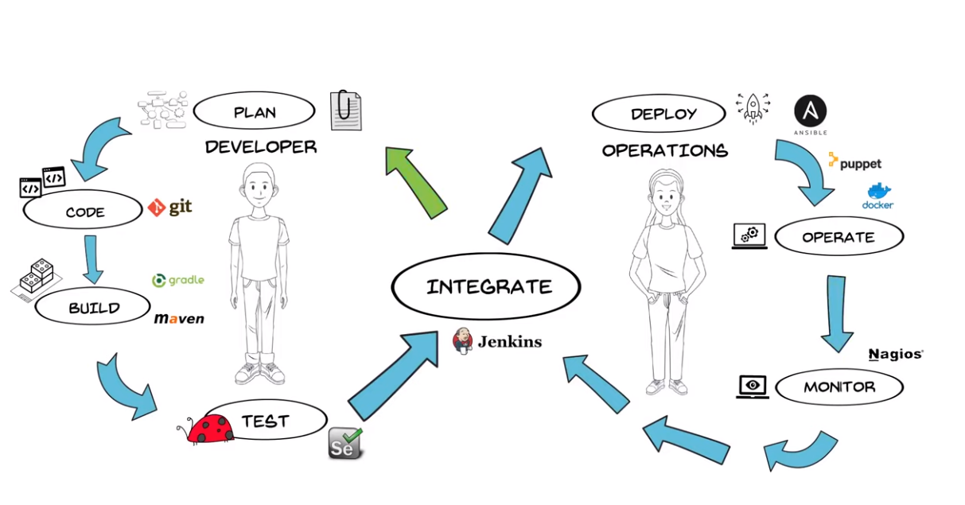
Notes:
Benefit from Devops:
Less time to market
Higher Quality
Less spending
Reduced outage
SCM : Git ,svn , TFS ,Perforce
Build & Packaging : Maven ,ANT, Gradle
CI : Jenkins ,Bamboo ,Hudson
Testing : Junit ,Selenium ,TestNG
Container: Docker ,Rkt
CM : puppet, Chef, Ansible ,salt stack
Monitoring : Splunk ,ELK,Nagois .

Slide 34



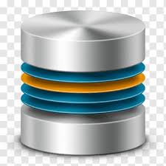










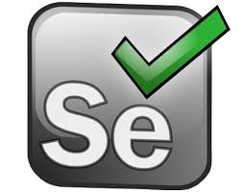








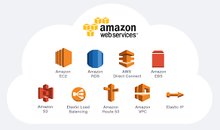

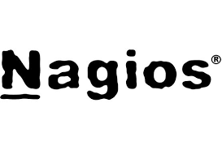
D
E
V
E
L
O
P
E
R
S

Slide 35
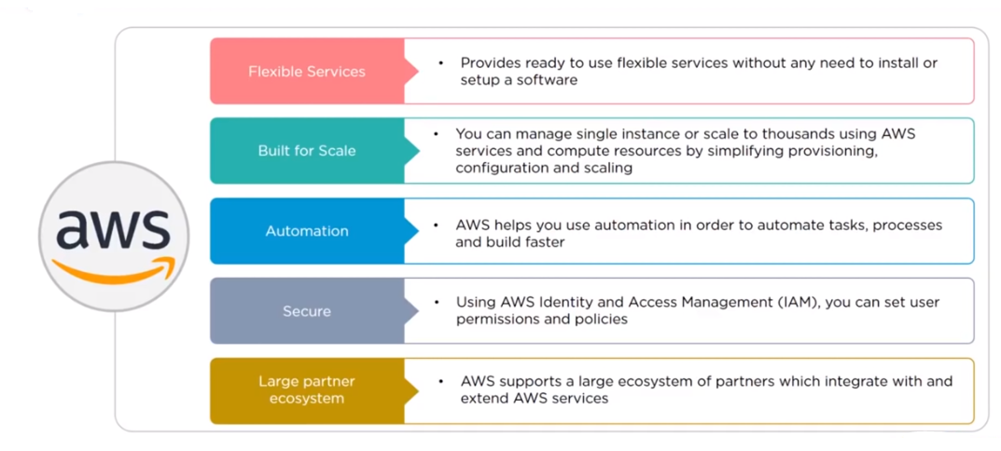

Slide 36
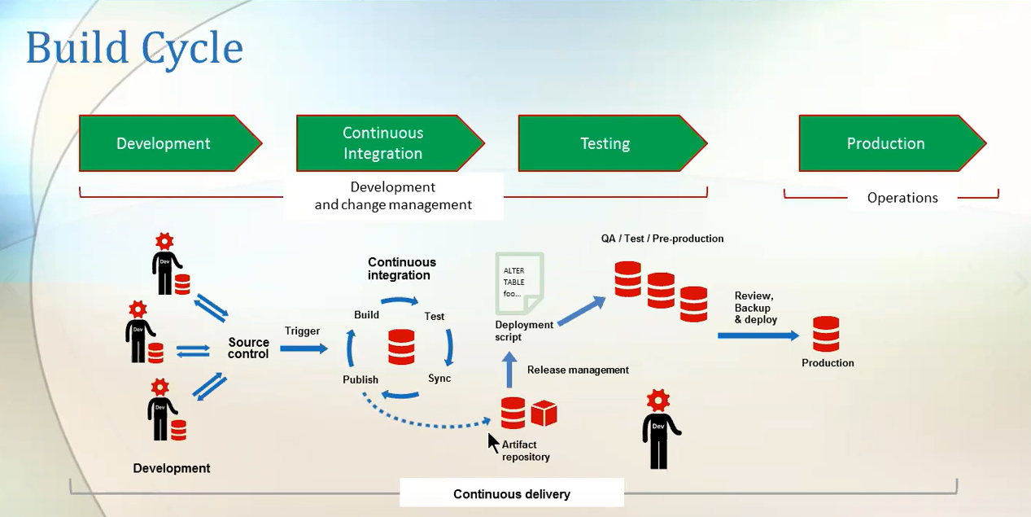

Slide 37
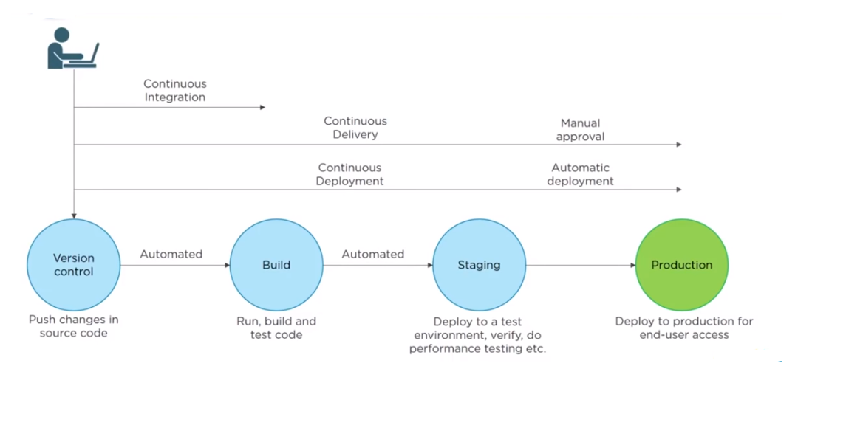

Slide 38
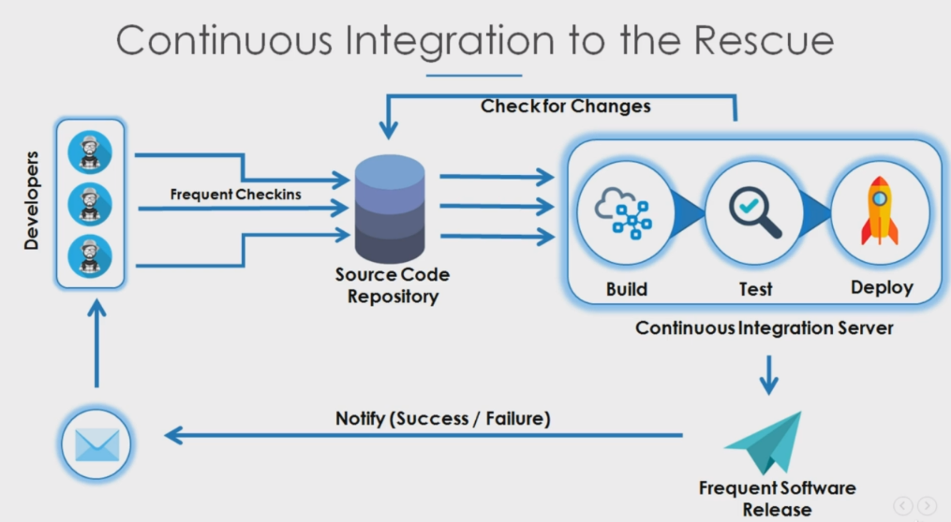
Notes:
Fast feedback to developers.
Easy for developer to fix issues .Hence productivity increases .
Improves code quality and minimizes defect .
Automates CI process
Github.com/javahometech

Slide 39

Notes:
Add slave machine :

Slide 40


Slide 41


